Slide 1
Risk Management Fundamentals
Notes:
Risk Management is important to the success of every company. Effective risk management starts by understanding threats and vulnerabilities.
You build on this knowledge by identifying ways to mitigate the risks. Risks can be mitigated by reducing vulnerabilities or reducing the impact of the risk.
You can then create different plans to mitigate risks in different areas of the company.

Slide 2
Objectives
Concepts associated with Risk Management
Components of Risk
Importance of Risk Management
Risk Identification
Risk Management Techniques

Slide 3
What Is Risk?
Risk is the likelihood that a loss will occur
Losses occur when a threat exposes a vulnerability
Major vs. minor risks
Profitability vs. survivability
Notes:
Mất mát xảy ra khi một mối đe dọa phơi bày một lỗ hổng
likelihood = possibility
- Both profitability and survivability must be considered when considering risks.
+ Profitability - The ability of a company to make a profit. Profitability is calculated as revenues minus costs.
+ Survivability - The ability of a company to survive loss due to a risk. Some losses such as fire can be disastrous and cause the business to fail.

Slide 4
Basic Concepts
Asset - information, property, people or anything else that we care about
Threat - a potential form of loss or damage; many threats are only potential threats, but we plan for them because they might happen
Threat agent - a vector for the threat, a way for the threat to occur; could be a person, an event, or a program running an attack
Vulnerability - a weak spot where an attack is more likely to succeed
Exploit - a method of attack
Notes:
tác nhân nguy hại
exploit khai thác

Slide 5
Basic Concepts (cont.)
Incident - a threat that has actually become a reality, an event that is or has caused loss to our organization
Probability of occurrence - the odds that a particular threat will exploit a particular vulnerability successfully
Impact - the kind (e.g. money, productivity, customer confidence) and scale (usually expressed in dollars) of loss that an occurrence would have on an organization; a high score here means we should concentrate some of our limited budget on protecting a particular asset
Notes:
Xác suất xảy ra - khả năng một mối đe dọa cụ thể sẽ khai thác thành công một lỗ hổng cụ thể

Slide 6
Basic Concepts (cont.)
Risk - A more formal definition of risk uses some of the terms above: Risk is the probability that a particular threat will exploit a vulnerability causing harm to an organization.
Control - A process that we put in place to reduce the impact and/or probability of a risk
Policy
a plan that influences decisions;
a guiding principle for decisions and actions;
a set of rules about what actions are acceptable and what actions are unacceptable
Notes:
Rủi ro là khả năng một mối đe dọa cụ thể sẽ khai thác lỗ hổng gây hại cho một tổ chức.

Slide 7
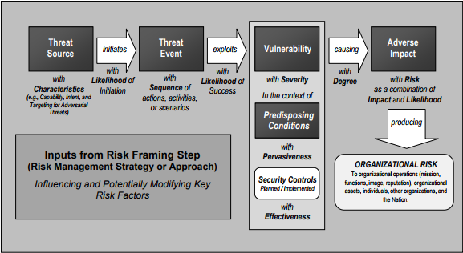
Generic Risk Model with Key Risk Factors
Notes:
bóc thăm giải thích sơ đồ
threat: mối đe doạ
exploit: khai thác
vulnerability: lỗ hổng
severity: mức độ nghiêm trọng
predisposing condition: điều kiên dự đoán
pərˈvāsivnəs
sức lan tỏa
adverse bất lợi / tác hại

Slide 8
Compromised Business Functions and Assets
Two value types:
tangible - usually expressed as a dollar (or other currency) value, the amount of income that assets produce over a specific time are tangible; values are generally tangible if you can associate a specific cost to their loss;
intangible - there is a value to having a good reputation, to having happy customers, to having employees who are proud to work for you, but each of these is hard to assign an actual profit or loss value. We recognize that they exist, but we are not sure of their worth. Organizations seem to either put faith in these values and cultivate them, or pay no attention to such things and pursue only tangible rewards.
Assets themselves can be classified as
tangible (physical assets, including data and intellectual property). or
intangible (reputation, service ratings, customer loyalty, service to prestigious customers).
Assets of both types can have values of both types.
Notes:
tangible: hữu hình
Các chức năng và tài sản kinh doanh bị xâm phạm

Slide 9
Driver of Business Costs
After risks are identified, steps can be taken to reduce or manage the risk:
Risks are often managed by implementing countermeasures or controls.
The costs of managing risk need to be considered in total business costs.
Profitability - revenues minus costs.
Survivability - The ability of a company to survive loss due to a risk.
Out-of-pocket-cost - the cost to reduce a risk with a particular control
Lost opportunity cost - Money spent to reduce risks can’t be spent elsewhere.
Future cost - the cost to maintain the control over time, which may come from licensing, subscription, or maintenance of a system
Client/stakeholder confidence - think of this as related to customer good will, which can be lost if our organization has a documented loss due to an attack
Notes:
countermeasure: biện pháp đối phó

Slide 10
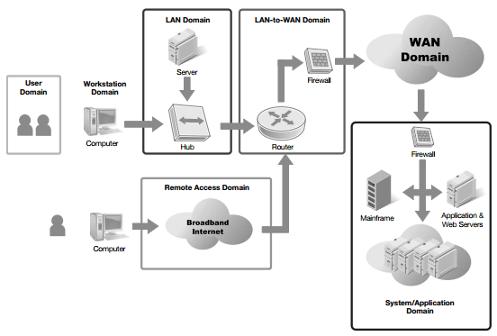
Major Components of Risk to an IT Infrastructure
The Seven Domains of a Typical IT Infrastructure
Notes:
chia nhóm trình bày ngắn về 7 domains
- User Domain (bao gồm con người nói chung, mắt xích yếu nhât, dễ bị social engineering)
- Workstation Domain (thiết bị của người dung cuối. Có thể bị nhiễm malware nếu không up-to-date)
- LAN Domain (kết nối nhiều thiết bị với nhau, như bình thương :))) ? )
The LAN Domain is the area that is inside the firewall. It can be a few systems connected together in small home office network. It can also be a large network with thousands of computers. Each individual device on the network must be protected or all devices can be at risk.
- LAN-to-WAN Domain
The LAN­-to-­WAN Domain connects the local area network to the wide area network (WAN). The LAN Domain is considered a trusted zone since it is controlled by a company. The WAN Domain is considered an untrusted zone because it is not controlled and is accessible by attackers.
The area between the trusted and untrusted zones is protected with one or more firewalls.
- Remote Access Domain
Mobile workers often need access to the private LAN when they are away from the company. Remote access is used to grant mobile workers this access. Remote access can be granted via direct dial­up connections or using a virtual private network (VPN) connection.
Vulnerabilities exist at two stages of the VPN connection: authentication (discovered) and when data is passed (capture).
- WAN Domain
For many businesses, the WAN is the Internet. However, a business can also lease semiprivate lines from private telecommunications companies. These lines are semiprivate because they are rarely leased and used by only a single company.
The Internet is an untrusted zone.
- System/Application Domain
The System/Application Domain refers to servers that host server level applications. Mail servers receive and send e­mail for clients. Database servers host databases that are accessed by users, applications, or other servers. Domain Name System (DNS) servers provide names to IP addresses for clients.

Slide 11
Seven Domains of a Typical IT Infrastructure
User domain - any user of our systems falls in this domain, whether inside or outside our organization
Workstation domain - not just computers, but any device our users use
LAN domain - each LAN and the devices that make a LAN work
WAN domain - the system that links devices across long distances; typically this is the Internet which is used by most businesses
LAN-to-WAN domain - the infrastructure and devices that connect our organization's LANs to the WAN system
Remote Access domain - the technologies used by our mobile and remote users to connect to their customary resources; can include VPN solutions and encryption technology
System/Application domain - technologies used to actually conduct business functions, as opposed to making connections of various types
Notes:
p. 5, 6

Slide 12
Threats, Vulnerabilities and Impact
Threat is any circumstance or event with the potential to cause a loss
Vulnerability is a weakness
The impact identifies the severity of the loss
Threats are attempts to exploit vulnerabilities that result in the loss of confidentiality, integrity, or availability of a business asset (The C-I-A triad).
Notes:
- Threats are attempts to exploit vulnerabilities that result in the loss of:
+ Confidentiality - Preventing unauthorized disclosure of information.
+ Integrity - Ensuring data or an IT system is not modified or destroyed.
+ Availability - Ensuring data and services are available when needed.
- Vulnerability could be a procedural, technical, or administrative weakness. It could be a weakness in physical security, technical security, or operational security.
- NIST SP 800­30 suggests the following impact terms:
+ High impact - If a threat exploits the vulnerability it may:
• Result in the costly loss of major assets or resources
• Significantly violate, harm, or impede an organization’s mission, reputation, or interest
• Or, result in human death or serious injury.
+ Medium impact - If a threat exploits the vulnerability it may:
• Result in the costly loss of assets or resources
• Violate, harm, or impede an organization’s mission, reputation, or interest
• Or, result in human injury.
+ Low impact - If a threat exploits the vulnerability it may:
• Result in the loss of some assets or resources
• Or, noticeably affect an organization’s mission, reputation, or interest.

Slide 13
Threats, Vulnerabilities and Impact (cont.)
The severity of a an attack's impact:
very low - negligible adverse effect; the effects are small and not noticeable
low - limited adverse effect; damage is minor and critical business functions are degraded
moderate - serious adverse effect; damage may be significant and critical business functions are significantly degraded
high - one severe or catastrophic effect; there may be major financial loss and and/or serious injury to staff
very high - multiple severe or catastrophic effects; see above
Notes:
negigible adverse: bất lợi không đáng kể
one severe or catastrophic effect: một tác động nghiêm trọng hoặc thảm khốc

Slide 14
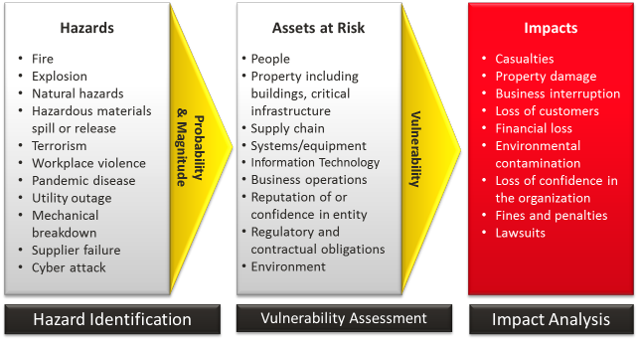
Risk Assessment Process Diagram
Notes:
https://www.ready.gov/risk-assessment

Slide 15
Risk Management
Risk Management is the practice of identifying, assessing, controlling, and mitigating risks.
Threats and vulnerabilities are key drivers of risk.
Identifying the threats and vulnerabilities - an important step.
Risk Management attempts to identify the risks
that can be minimized and implement controls to do so.
Risk Management starts with a Risk Assessment (or Risk Analysis).
Notes:
- Risk assessment - Risk management starts with a risk assessment or risk analysis. There are multiple steps to a risk assessment:
+ Identify the IT assets of an organization and their value.
+ Identify threats and vulnerabilities to these assets.
+ Identify the likelihood a vulnerability will be exploited by a threat.
+ Identify the impact of a risk.
- Identify risks to manage - You can choose to avoid, transfer, mitigate, or accept risks.
- Selection of controls - After you have identified what risks to address, you can identify and select control methods.
- Implementation and testing of controls - Once the controls are implemented, you can test them to ensure they provide the expected protection.
- Evaluation of controls - Risk management is an ongoing process. You should regularly evaluate implemented controls to determine if they still provide the expected
protection.

Slide 16
Elements of Risk Management
Assessing risks
Identify assets, including IT assets
Identify and prioritize threats and vulnerabilities
Identify likelihood that each vulnerability will be successfully exploited by each threat: risks
Identify the impact of each risk
Identifying risks to manage
Selecting controls
Implementing and testing controls
Evaluating controls over time
Notes:
- Risk assessment - Risk management starts with a risk assessment or risk analysis. There are multiple steps to a risk assessment:
+ Identify the IT assets of an organization and their value.
+ Identify threats and vulnerabilities to these assets.
+ Identify the likelihood a vulnerability will be exploited by a threat.
+ Identify the impact of a risk.
- Identify risks to manage - You can choose to avoid, transfer, mitigate, or accept risks.
- Selection of controls - After you have identified what risks to address, you can identify and select control methods.
- Implementation and testing of controls - Once the controls are implemented, you can test them to ensure they provide the expected protection.
- Evaluation of controls - Risk management is an ongoing process. You should regularly evaluate implemented controls to determine if they still provide the expected
protection.

Slide 17
Importance of Risk Management to the Organization
Risk affects an organization’s survivability
Reasonableness
Balancing Risk and Cost
Role-Based Perceptions of Risk
Balancing security and usability
Different perceptions of risk, varying according to a person's role in the organization:
Management
System administrator
Tier 1 administrator
Developer
End user
Notes:
- Reasonableness is a test that can be applied to risk management to determine if the risk should be managed. It’s derived from the reasonable ­person standard in law.
In short, you should answer this question. “Would a reasonable person be expected to manage this risk?”
- Balancing Risk and Cost
The cost to manage the risk must be balanced against the impact value. The costs can be measured in actual monetary values if they are available. You can also balance the costs using relative values such as low, medium, and high.
- Role-Based Perceptions of Risk
Risks and risk management are often perceived quite differently. It is common for individuals in the followings roles to have different perceptions of risk:
+ Management- Management is concerned mostly with profitability and survivability. Their view of the risk is based on the costs of the risk and the costs of the controls.
+ System administrator - Administrators are responsible for protecting the IT systems. They understand the risks.
+ Tier 1 administrator - Tier 1 administrators are the first line of defense for IT support. They may be more concerned with usability than security or profitability.
+ Developer - Some companies have in-­house application developers. Many developers have adopted a secure computing mindset.
+ End user - End users simply want the computer to work for them. They are most concerned with usability.

Slide 18
Balancing Risk and Cost
A simplified method of assigning a score to a threat:
Assigning the threat, a probability of occurring in percentage.
Assigning the asset a relative value on a scale of 1 to 100.
Multiplying the two values - getting a relative impact score.
Notes:
dọc: khả năng xảy ra
ngang: hậu quả

Slide 19
Risk Identification Techniques
Identify threats
Identify vulnerabilities
Estimate the likelihood of a threat exploiting a vulnerability
Notes:
You’ll need to take three steps:
- Identifying Threats
A threat is any circumstance or event with the potential to cause a loss. The loss or danger is directly related to one of the following:
loss of confidentiality, loss of integrity, loss of availability.
Threat identification is the process of creating a list of threats. Threats are often considered in the following categories:
external or internal, natural or man-made, intentional or accidental.
- Identifying Vulnerabilities
Some of the sources you can use are: audits, certification and accreditation records, system logs, prior events, trouble reports, incident response teams.
- Estimate the likelihood of a threat exploiting a vulnerability
Pairing Threats with Vulnerabilities
Total Risk = Threat x Vulnerability x Asset Value

Slide 20
Identifying Threats
Loss of confidentiality
Loss of integrity
Loss of availability
External or internal
Natural or man-made
Intentional or accidental

Slide 21
Threats: Examples
An unauthorized employee trying to access data
Any type of malware
An attacker defacing a Web site
Any DoS or DDoS attack
An external attacker trying to access data
Any loss of data
Any loss of services

Slide 22
Threats: Examples (cont.)
A social engineer tricking an employee into revealing a secret
Earthquakes, floods, or hurricanes
A lightning strike
Electrical, heating, or air conditioning outages
Fires

Slide 23
Identifying Vulnerabilities
A short list of sources of information telling us about vulnerabilities and attacks against them:
Audits
Certification and accreditation records
System logs
Prior events
Trouble reports
Incident response team records
Notes:
chứng chỉ và công nhận

Slide 24
Using the Seven Domains of a Typical IT Infrastructure to Identify Weaknesses
User Domain - social engineering attacks begin with people, such as any of our system users
Workstation Domain - computers that are not patched, and those whose antivirus or antimalware programs are not regularly updated are vulnerable
LAN Domain - network data needs protection, typically with access controls as the first line of defense
WAN Domain - this domain contains our public facing devices, such as our web servers, which are primary targets for attackers
LAN-to-WAN Domain - this domain provides our users with access to the Internet, including all the dangers that lurk in it
Remote Access Domain - remote users may be using their own equipment (e.g. storage media, smartphone, and personal computers), which may have been exposed to viruses and malware without the user knowing about it
System/Application Domain - a common attack ploy is to inject SQL code into forms, web pages, and entry fields in programs that our users and customers are meant to use
Notes:
lurk: núp

Slide 25
Pairing Threats with Vulnerabilities
Threats are matched to existing vulnerabilities to determine the likelihood of a risk.
Risk = Threat  Vulnerability (*)
Threat and vulnerability often don’t have numerical values.
(*) is designed to show the relationship between the two.
Total Risk = Threat  Vulnerability  Asset Value
Notes:
give some examples: hut thuoc
Rủi ro = Mối đe dọa x lo hong
Các mối đe dọa được đối sánh với các lỗ hổng hiện có để xác định khả năng xảy ra rủi ro

Slide 26
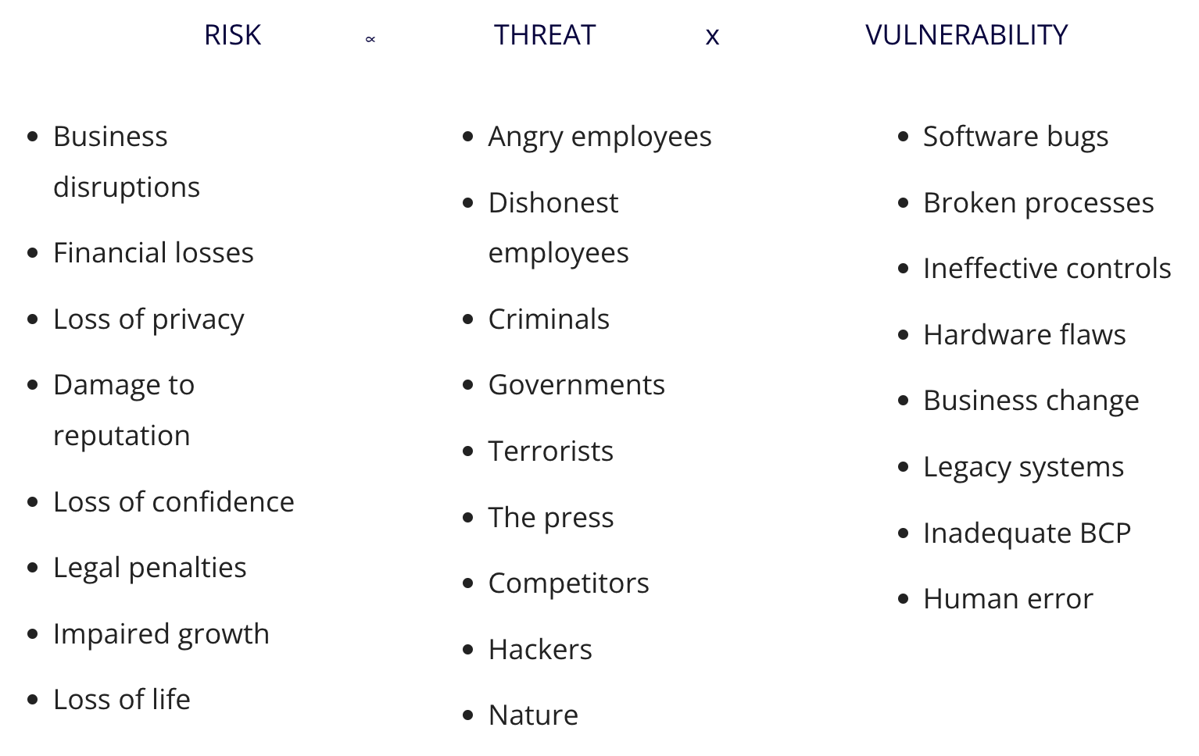
Pairing Threats with Vulnerabilities (matrix)
Notes:
matrix, not a formula

Slide 27
Risk Management Techniques
Major steps of Risk Management:
Identifying risks
Assessing risks
Determining which risks will be handled and which risks will accepted
Taking steps to reduce risk to an acceptable level.
Handling a risk:
Avoidance
Transference
Mitigation
Acceptance

Slide 28
Risk Management Techniques (cont.)
Avoidance:
make every effort to avoid your vulnerabilities being exploited; make the attack less possible, make the threat less likely to occur; avoid risk by avoiding the activity associated with the risk, and by providing an active defense against it; the text calls this a business decision
Transference:
in general, letting someone else worry about it. In the ITIL model, this is included in the definition of a service: "A service is a means of delivering value to customers by facilitating outcomes customers want to achieve without the ownership of specific costs and risks“. A reader might misunderstand this statement, thinking that the customer does not pay anything. That is not the case. An IT service provider would assume the costs and risks of an operation in return for the customer's payment for the service. This can be done in-house or by outsourcing.
Notes:
- Avoidance
+ Eliminating the source of the risk - The company can stop the risky activity.
+ Eliminating the exposure of assets to the risk - The company can move the asset.
- Transfer
You can transfer risk by shifting responsibility to another party.
+ Insurance - You purchase insurance to protect your company from a loss.
+ Outsourcing the activity. - Your company and the provider can agree on who assumes responsibility for security, backups, and availability.
- Mitigation
You reduce risk by reducing vulnerabilities, and risk mitigation is the primary strategy in this process. Risk mitigation is also known as reduction or treatment.
Some examples of mitigation steps are: alter the physical environment, change procedures, add fault tolerance, modify the technical environment, train employees.
Often the goal is not to eliminate the risk but instead, to make it too expensive for the attacker. Cryptography is one of the ways to increase the attacker’s cost.
- Acceptance
A company can evaluate a risk, understand the potential loss, and choose to accept it. This is commonly done when the cost of the control outweighs the potential loss.

Slide 29
Risk Management Techniques (cont.)
Mitigation:
this method seeks to reduce the effects of an attack, to minimize and contain the damage that an attack can do; Incident Response plans, Business Continuity plans, and Disaster Recovery plans are all part of a mitigation plan
Acceptance:
this counterintuitive idea makes sense if the cost of an incident is minimal, and the cost of each of the other methods is too high to accept; the basic idea here is that it costs less just to let it happen in some cases, and to clean up afterward; this can also be the case when the risk cannot be managed other than to be aware of it; the text says this is either a business or a technology decision
Notes:
- Avoidance
+ Eliminating the source of the risk - The company can stop the risky activity.
+ Eliminating the exposure of assets to the risk - The company can move the asset.
- Transfer
You can transfer risk by shifting responsibility to another party.
+ Insurance - You purchase insurance to protect your company from a loss.
+ Outsourcing the activity. - Your company and the provider can agree on who assumes responsibility for security, backups, and availability.
- Mitigation
You reduce risk by reducing vulnerabilities, and risk mitigation is the primary strategy in this process. Risk mitigation is also known as reduction or treatment.
Some examples of mitigation steps are: alter the physical environment, change procedures, add fault tolerance, modify the technical environment, train employees.
Often the goal is not to eliminate the risk but instead, to make it too expensive for the attacker. Cryptography is one of the ways to increase the attacker’s cost.
- Acceptance
A company can evaluate a risk, understand the potential loss, and choose to accept it. This is commonly done when the cost of the control outweighs the potential loss.

Slide 30
Cost-Benefit Analysis (CBA)
Performing a CBA to help determine which controls or countermeasures to implement.
A CBA starts by gathering data to identify the costs of the controls:
Cost of the control - This includes the purchase costs plus the operational costs over the lifetime of the control.
Projected benefits - This includes the potential benefits gained from implementing the control. You identify these benefits by examining the costs of the loss and how much the loss will be reduced if the control is implemented.
Some of the hidden costs may be:
Costs to train employees
Costs for ongoing maintenance
Software and hardware renewal costs
Notes:
- CBA
You perform a cost-benefit analysis (CBA) to help determine which controls or countermeasures to implement. If the benefits lớn hơn the costs, the control is often selected.
- Residual Risk
Residual risk is the risk that remains after you apply controls. It’s not feasible to eliminate all risks. Instead, you take steps to reduce the risk to an acceptable level. The risk that’s left is residual risk.
Risk = Threat x Vulnerability
Total Risk = Threat x Vulnerability x Asset Value
Residual Risk = Total Risk - Controls

Slide 31
Residual Risk
Residual risk - the risk that remains after applying controls.
Taking steps to reduce the risk to an acceptable level:
The risk that’s left is residual risk.
Residual Risk = Total Risk  Controls
Notes:
Residual risk rủi ro còn lại

Slide 32
Chapter 1 - Summary
Risks occur when threats exploit vulnerabilities, resulting in a loss.
The loss can compromise business functions and business assets.
Losses also drive business costs.
Risk management helps a company identify risks that need to be reduced.
The first steps in risk management are to identify threats and vulnerabilities.
These can then be paired to helpdetermine the severity of the risk.
You can manage risks by choosing one of four techniques: A risk can be avoided, shared or transferred, mitigated, or accepted.
The primary risk management technique is risk mitigation.
Risk mitigation is also known as risk reduction or risk treatment.
You reduce vulnerabilities by implementing controls.
Notes:
tìm keywords trong đoạn

